Slide 1
Algorithm Design and Analysis
CS240 Spring 2024
Rui Fan

Slide 2
Course info
Assoc. Prof. Rui Fan / 范睿
Email: fanrui@shanghaitech.edu.cn
Office: SIST 1A-504E
Office hours Thursdays 3-4PM.
My research is parallel and distributed computing.
Lecture notes on Blackboard, discussions on Piazza, grading on GradeScope.
References
Algorithm Design. Kleinberg, Tardos.
Introduction to Algorithms, 3rd edition. Cormen, Leiserson, Rivest, Stein.

Slide 3
Grading
Problem sets | Project | Midterm | Final exam
35% | 15% | 20% | 30%
~6 problem sets | Due end of week 16 | Week 7 in class
Recitations
Problem set solutions and discussions.
TAs, recitation time / place TBA.
Project
Write programs to solve programming contest style algorithm problems with time and memory limits.

Slide 4

Random number generator
Reference counting
Randomized algorithms
Euclid’s algorithm
Markov chain Monte Carlo
Recursive functions
Ackermann function
Power iteration
Binary search
Polynomial time
Network flow
A* search
Fast Fourier Transform
Public key encryption
Reed-Solomon codes
Quantum algorithms
Huffman encoding
Linear programming
Chinese remainder theorem
Sieve of Eratosthenes
Graph isomorphism
NP-completeness
Strassen’s algorithm
Painter’s algorithm
Preconditioning
Deep learning
Auction algorithms
Computational biology
Divide and conquer
Interior point methods
Zero knowledge proofs
Clustering
Cuthill-Mckee
Traveling salesman problem
TCP/IP
Elliptic curve factorization
Johnson-Lindenstrauss theorem
Spline interpolation
Primal-dual algorithms
Principle component analysis
DNA sequence alignment
Satisfiability
Newton’s method
Parallel algorithms
List scheduling
Quicksort
Voronoi diagram
Strongly connected components
External memory algorithms
Support vector machines
Convex hulls
Maximum matching
Quad trees
Dynamic programming
Secret sharing
Kolmogorov complexity
Branch and bound
Bayesian inference
Red-black trees
Dijkstra’s algorithm
AES algorithm
Graph coloring
Integer programming
Discrete logarithms
Splay trees
Lamport clocks
Mutual exclusion
LRU caching
Maximum independent set
Minimum spanning tree
AKS primality test
Streaming algorithms
Online algorithms
Davis-Putnam algorithm
B-trees
MPEG compression
Bloom filters
Simplex algorithm
Approximation algorithms
Clock synchronization
Byzantine agreement
Ellipsoid algorithm
Union-find
Nondeterministic finite automata
Conjugate gradient
Chaitin’s algorithm
Topological sort
VC dimension
Distributed algorithms
N-body problems
Neural networks
PageRank
Ray tracing
Perfect hashing

Slide 5
Course content
Analysis of algorithms
Divide and conquer
Greedy algorithms
Dynamic programming
Network flow
NP and complexity
Overcoming intractability
Randomized algorithms
Approximation algorithms

Slide 6
What is an algorithm?
A precise, step-by-step procedure for solving a problem.
Take an input (an instance of the problem).
Perform a sequence of operations on data from the instance.
Produce an output (solution to the instance).

Slide 7
Expressing algorithms
An algorithm is a method for solving a given problem.
A program expresses the algorithm in a way a computer can understand.
Can use many different languages (C / C++ / Java / Python / ...) to express the same algorithm.
Data structures are different ways to store data used by an algorithm.
Ex A dictionary can be stored as linked list, array, tree, etc.
Using the right data structure makes an algorithm more efficient.

Slide 8
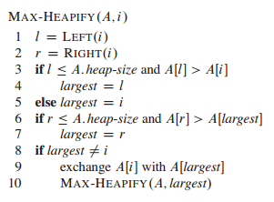
Pseudocode
We’ll mostly write our algorithms in pseudocode.
Precisely captures main ideas of algorithm without getting bogged down in details.
You should practice translating between pseudocode and real code.

Slide 9
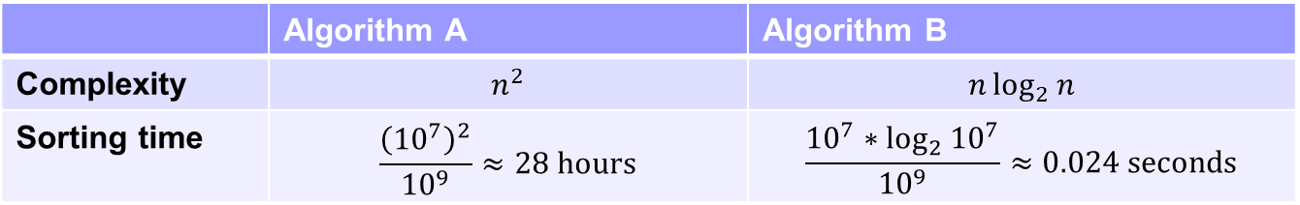
Comparing algorithms
A problem can be solved by many different algorithms.
Some algorithms are better than others.
We focus on the time and memory complexity of an algorithm.
The less time and memory an algorithm uses, the better.
Other important measures include speed on real hardware, parallelism, energy use, simplicity and elegance, etc.
Can also compare amount of randomness needed, approximation ratio, competitive ratio, etc.
Good algorithms are the key to efficiency.
Ex Use two algorithms to sort 10M numbers, on a processor which takes 1 billion steps per second.
Better algorithms are more important than faster hardware.
Ex Even if processor speed doubles every year, in 10 years algorithm A would still take ~100 seconds.
 | Algorithm A | Algorithm B
Complexity | $$n^{2}$$ | $$n\log_{2}{n}$$
Sorting time | $$\frac{{\left({10}^{7}\right)}^{2}}{{10}^{9}}≈28 hours$$ | $$\frac{{10}^{7}∗\log_{2}{{10}^{7}}}{{10}^{9}}≈0.024 seconds$$

Slide 10
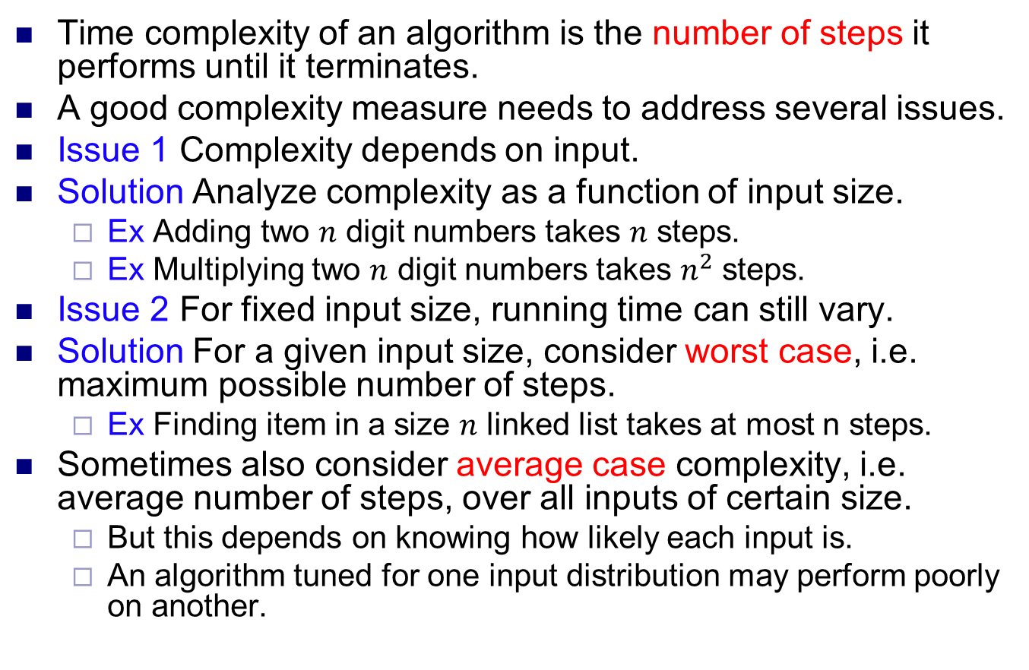
Time complexity
Time complexity of an algorithm is the number of steps it performs until it terminates.
A good complexity measure needs to address several issues.
Issue 1 Complexity depends on input.
Solution Analyze complexity as a function of input size.
Ex Adding two $n$ digit numbers takes $n$ steps.
Ex Multiplying two $n$ digit numbers takes $n^{2}$ steps.
Issue 2 For fixed input size, running time can still vary.
Solution For a given input size, consider worst case, i.e. maximum possible number of steps.
Ex Finding item in a size $n$ linked list takes at most n steps.
Sometimes also consider average case complexity, i.e. average number of steps, over all inputs of certain size.
But this depends on knowing how likely each input is.
An algorithm tuned for one input distribution may perform poorly on another.

Slide 11
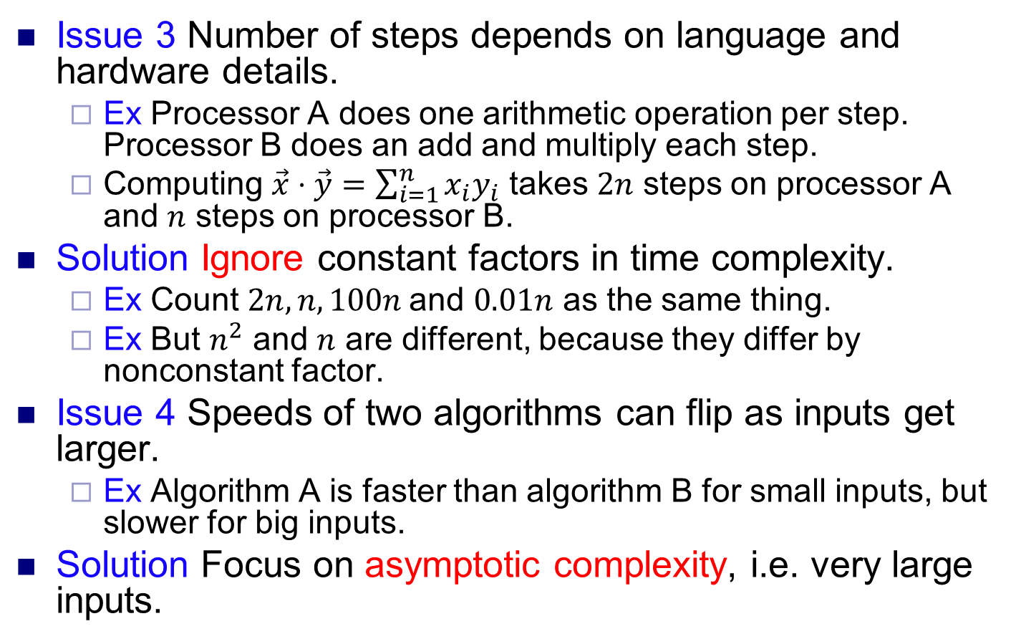
Time complexity
Issue 3 Number of steps depends on language and hardware details.
Ex Processor A does one arithmetic operation per step. Processor B does an add and multiply each step.
Computing $\vec{x}⋅\vec{y}=\sum_{i=1}^{n}{x_{i}y_{i}}$ takes $2n$ steps on processor A and $n$ steps on processor B.
Solution Ignore constant factors in time complexity.
Ex Count $2n, n, 100n$and $0.01n$ as the same thing.
Ex But $n^{2}$ and $n$ are different, because they differ by nonconstant factor.
Issue 4 Speeds of two algorithms can flip as inputs get larger.
Ex Algorithm A is faster than algorithm B for small inputs, but slower for big inputs.
Solution Focus on asymptotic complexity, i.e. very large inputs.

Slide 12
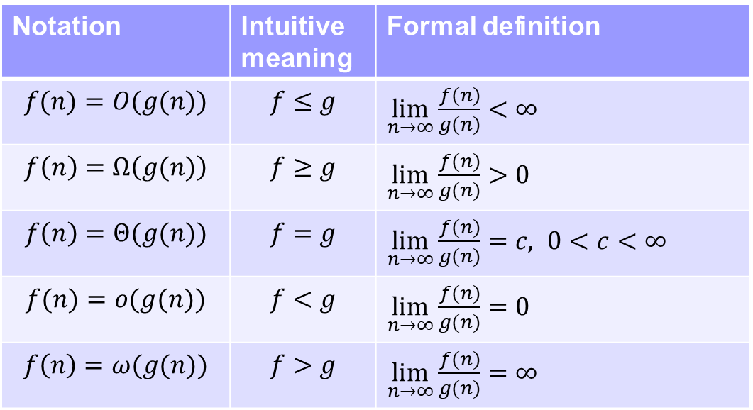
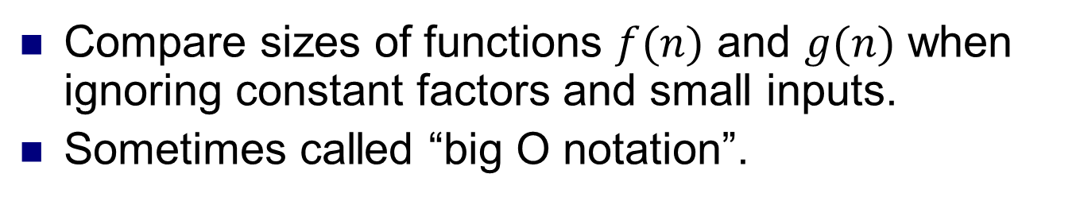
Asymptotic analysis
Compare sizes of functions $f(n)$ and $g(n)$ when ignoring constant factors and small inputs.
Sometimes called “big O notation”.
Notation | Intuitive meaning | Formal definition
$$f(n)=O(g(n))$$ | $$f≤g$$ | $\lim_{n→∞}\frac{f(n)}{g(n)}<∞$
$$f\left(n\right)=Ω\left(g(n)\right)$$ | $$f≥g$$ | $\lim_{n→∞}\frac{f(n)}{g(n)}>0$
$$f\left(n\right)=Θ(g(n))$$ | $$f=g$$ | $\lim_{n→∞}\frac{f(n)}{g(n)}=c, 0<c<∞$
$$f(n)=o(g(n))$$ | $$f<g$$ | $\lim_{n→∞}\frac{f(n)}{g(n)}=0$
$$f\left(n\right)=ω(g(n))$$ | $$f>g$$ | $\lim_{n→∞}\frac{f(n)}{g(n)}=∞$

Slide 13
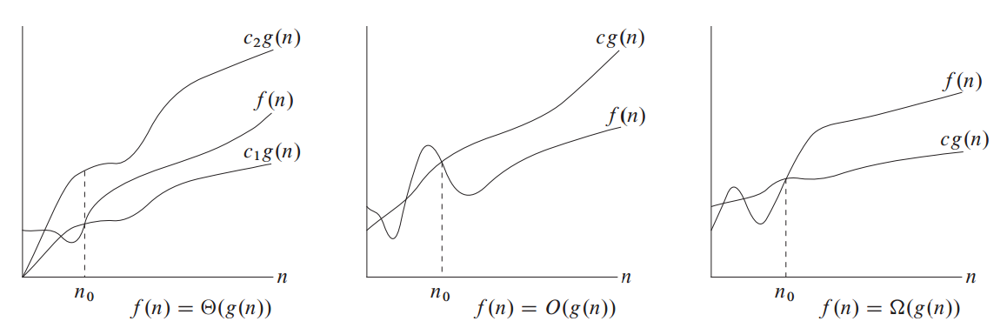
Big O pictorially
Source: Introduction to Algorithms
Cormen, Leiserson, Rivest, Stein

Slide 14
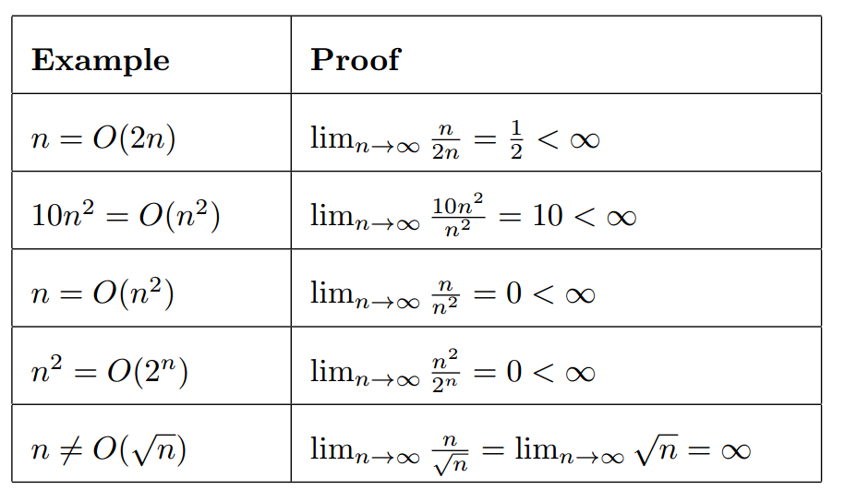
Examples 1

Slide 15
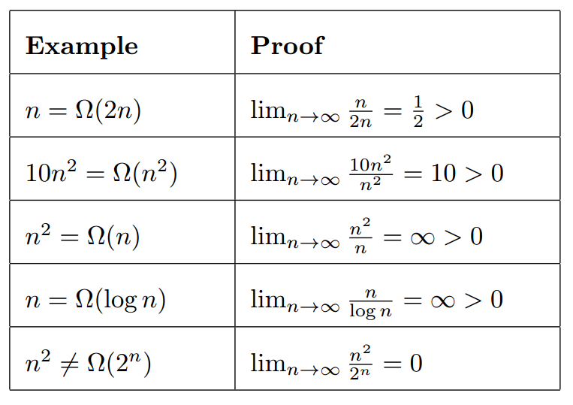
Examples 2

Slide 16
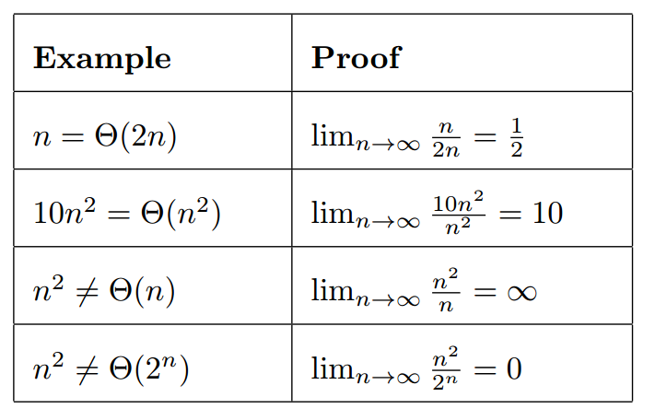
Examples 3

Slide 17
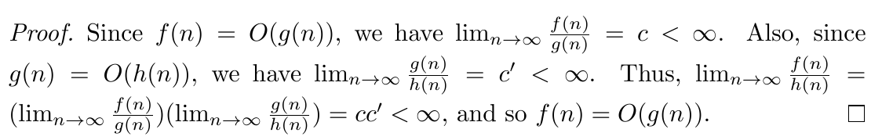
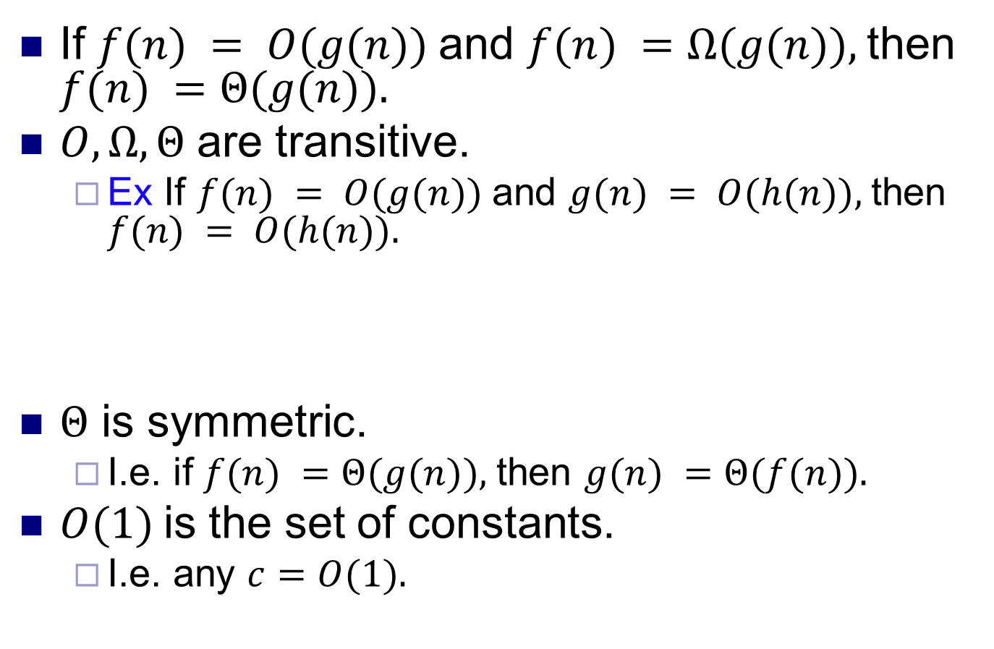
Big O properties
If $f(n) = O(g(n))$and $f(n) =Ω(g(n)),$then $f(n) =Θ(g(n)).$
$O, Ω, Θ$ are transitive.
Ex If $f(n) = O(g(n))$and $g(n) = O(h(n)),$then $f(n) = O(h(n)).$
$Θ$ is symmetric.
I.e. if $f(n) =Θ(g(n)),$then $g(n) =Θ(f(n)).$
$O(1)$is the set of constants.
I.e. any $c=O(1).$

Slide 18
Analyzing complexity
All programs can be written using loops, if-else structures, and recursion.
Analyze the complexity of each of type of structure.

Slide 19
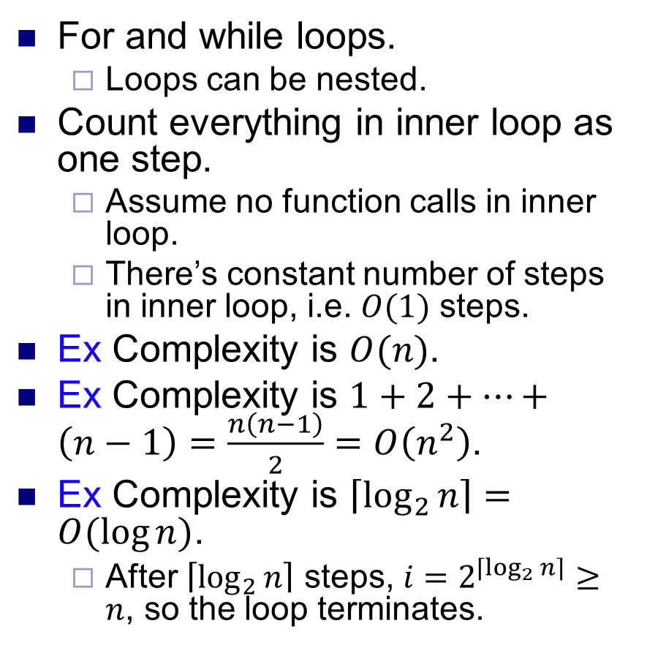
Loops
for(i=0; i<n; i++) {
j = j+i;
k = k*j;
}
For and while loops.
Loops can be nested.
Count everything in inner loop as one step.
Assume no function calls in inner loop.
There’s constant number of steps in inner loop, i.e. $O(1)$ steps.
Ex Complexity is $O(n)$.
Ex Complexity is $1+2+…+\left(n−1\right)=\frac{n\left(n−1\right)}{2}=O\left(n^{2}\right)$.
Ex Complexity is $\left\lceil \log_{2}{n}\right\rceil =O(\log{n)}$.
After $\left\lceil \log_{2}{n}\right\rceil$ steps, $i=2^{\left\lceil \log_{2}{n}\right\rceil }≥n$, so the loop terminates.
for(i=0; i<n; i++) {
for(j=0; j<i; j++) {
printf(“*”);
}
printf(“\n”);
}
*
**
***
****
*****
i=1;
while (i<n) {
i=i*2;
// do stuff
}

Slide 20
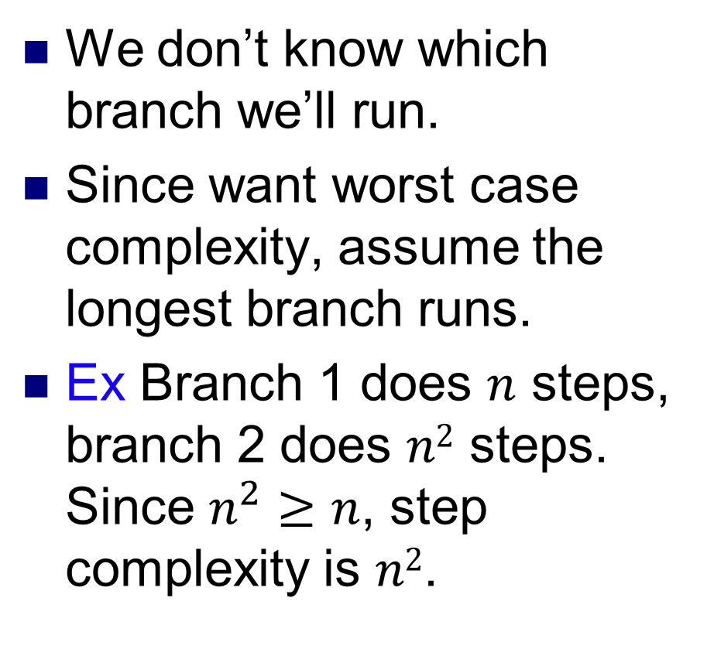
if-else statements
We don’t know which branch we’ll run.
Since want worst case complexity, assume the longest branch runs.
Ex Branch 1 does $n$ steps, branch 2 does $n2$ steps. Since $n^{2}≥n$, step complexity is $n2$.
if (x==1)
// do stuff A
else if (x==2)
// do stuff B
...
else
// do stuff Z
if (x==1)
for(i=0;i<n;i++) {
// do stuff
}
else if (x==2)
for(i=0;i<n;i++)
for(j=0;j<n;j++) {
// do stuff
}

Slide 21
Recursive functions
Recursive functions can call themselves.
Many problems are “self reducible”, i.e. we can solve the problem by first solving smaller instances of the problem.
Natural to use recursive algorithm to solve these problems.
There must be a base case that’s solvable directly, without using recursion.
Ex Let sum(n)=1+2+...+n.
Then sum(n) = n + sum(n-1).
The base case is n=1, for which sum(1)=1.
int sum(int n) {
if (n==1)
return 1;
else
return n+sum(n-1);
}

Slide 22
Analyzing recursive algorithms
Two main steps.
Find a recurrence relation for the time complexity.
Solve the recurrence relation.
Several ways to solve a recurrence relation.
Solve it directly, e.g. based on a guess.
Substitution method.
Recursion tree.
Master method.
For first three methods, need to prove solution is correct using mathematical induction.

Slide 23
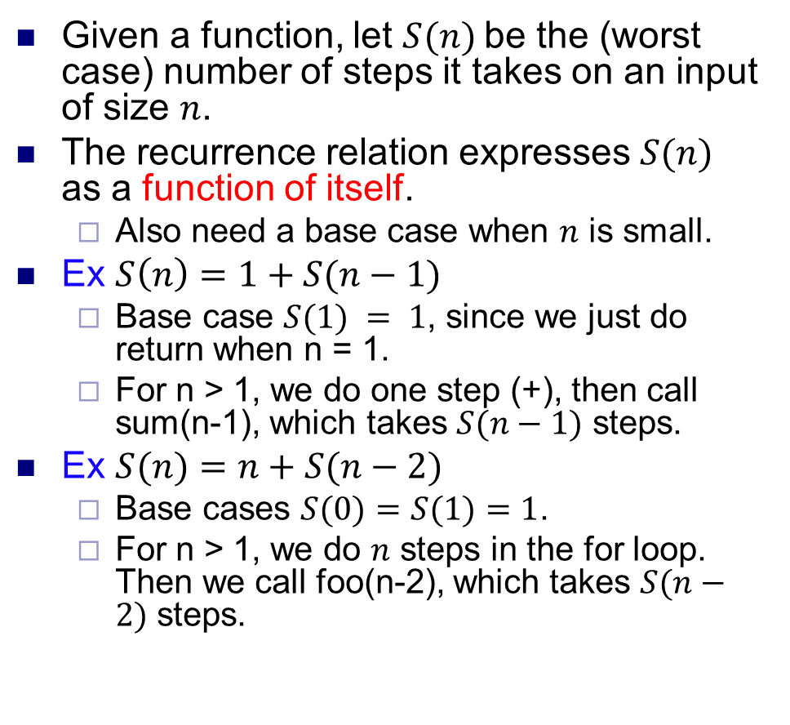
Finding a recurrence relation
Given a function, let $S(n)$be the (worst case) number of steps it takes on an input of size $n$.
The recurrence relation expresses $S(n)$ as a function of itself.
Also need a base case when $n$ is small.
Ex $S\left(n\right)=1+S(n−1)$
Base case $S(1) = 1$, since we just do return when n = 1.
For n > 1, we do one step (+), then call sum(n-1), which takes $S(n−1)$ steps.
Ex $S(n)=n+S(n−2)$
Base cases $S(0)=S(1)=1$.
For n > 1, we do $n$ steps in the for loop. Then we call foo(n-2), which takes $S(n−2)$ steps.
int sum(int n) {
if (n==1)
return 1;
else
return n+sum(n-1);
}
void foo(int n) {
if (n<=1)
return;
for(i=0; i<n; i++) {
// do stuff }
return foo(n-2);
}

Slide 24
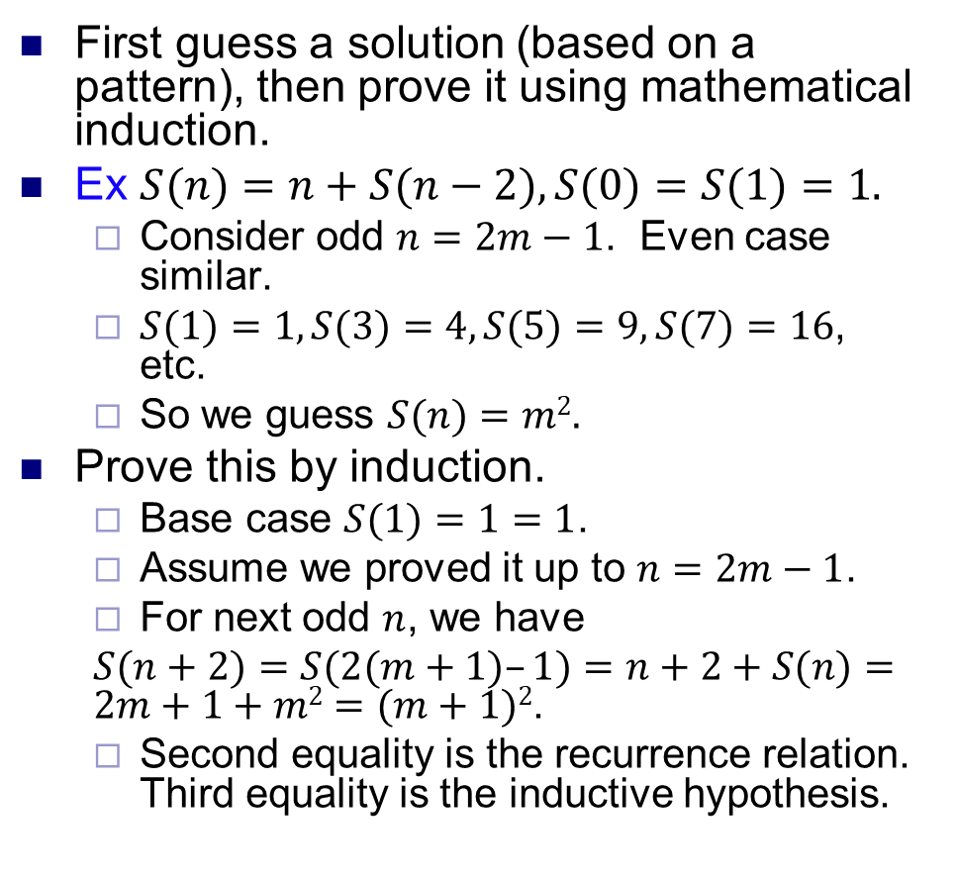
Direct solution
First guess a solution (based on a pattern), then prove it using mathematical induction.
Ex $S(n)=n+S(n−2), S(0)=S(1)=1.$
Consider odd $n=2m−1$. Even case similar.
$S(1)=1, S(3)=4, S(5)=9, S(7)=16$, etc.
So we guess $S(n)=m2.$
Prove this by induction.
Base case $S(1)=1=1$.
Assume we proved it up to $n=2m−1$.
For next odd $n$, we have
$S(n+2)=S(2(m+1)–1)=n+2+S(n)=2m+1+m2=(m+1)2$.
Second equality is the recurrence relation. Third equality is the inductive hypothesis.
void foo(int n) {
if (n<=1)
return;
for(i=0; i<n; i++) {
// do stuff }
return foo(n-2);
}

Slide 25
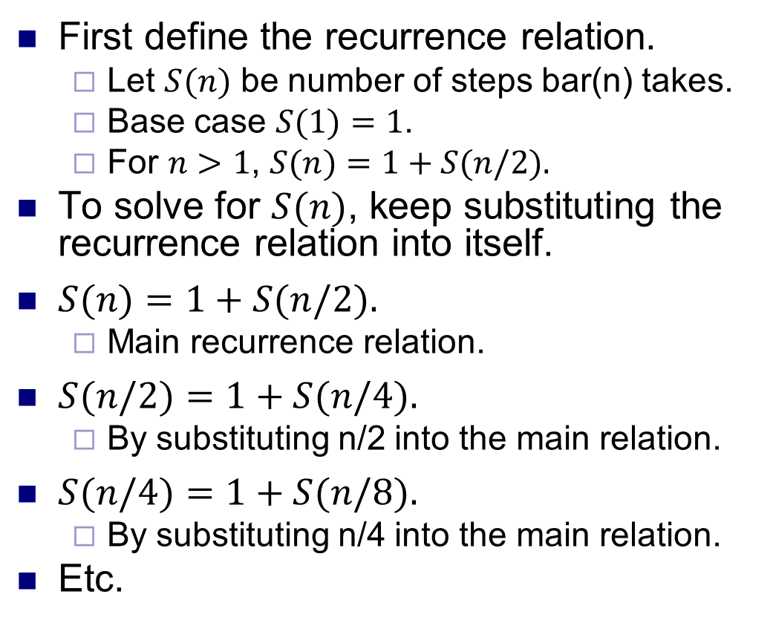
Substitution method
First define the recurrence relation.
Let $S(n)$ be number of steps bar(n) takes.
Base case $S(1)=1$.
For $n>1$, $S(n)=1+S(n/2).$
To solve for $S(n)$, keep substituting the recurrence relation into itself.
$S(n)=1+S(n/2).$
Main recurrence relation.
$S(n/2)=1+S(n/4).$
By substituting n/2 into the main relation.
$S(n/4)=1+S(n/8).$
By substituting n/4 into the main relation.
Etc.
int bar(int n) {
if (n<=1)
return 0;
return 1+bar(n/2);
}

Slide 26
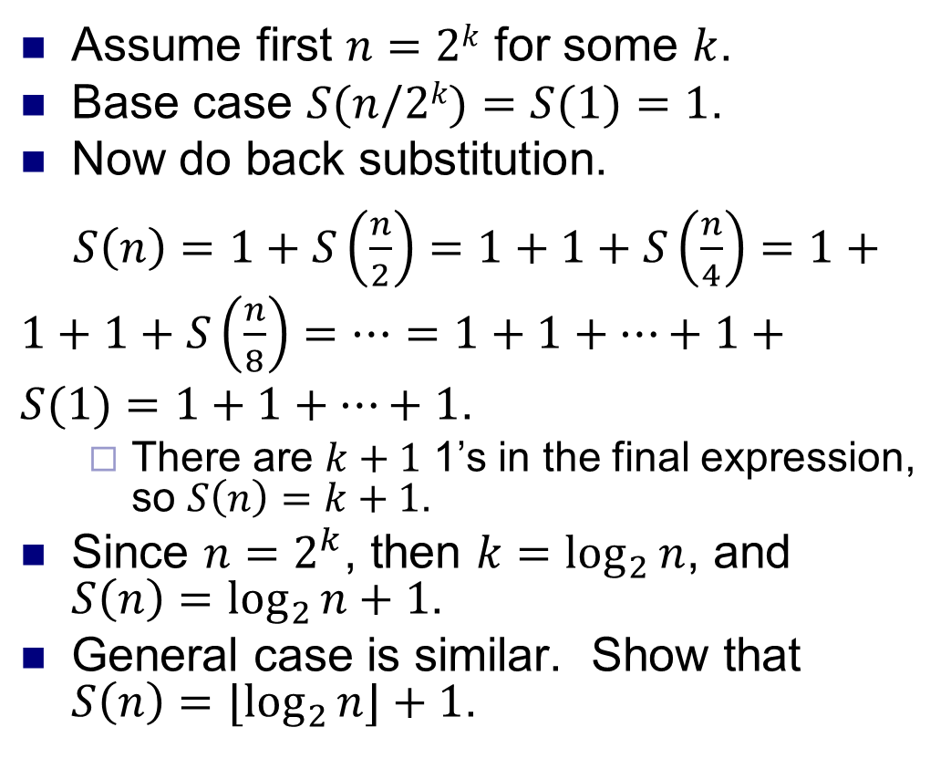
Substitution method
Assume first $n=2k$ for some $k$.
Base case $S(n/2k)=S(1)=1$.
Now do back substitution.
$S\left(n\right)=1+S\left(\frac{n}{2}\right)=1+1+S\left(\frac{n}{4}\right)=1+1+1+S\left(\frac{n}{8}\right)=⋯=1+1+…+1+S(1)=1+1+…+1$.
There are $k+1$ 1’s in the final expression, so $S\left(n\right)=k+1$.
Since $n=2^{k}$, then $k=\log_{2}{n}$, and $S\left(n\right)=\log_{2}{n+1}$.
General case is similar. Show that $S\left(n\right)=⌊\log_{2}{n⌋+1}$.
int bar(int n) {
if (n<=1)
return 0;
return 1+bar(n/2);
}

Slide 27
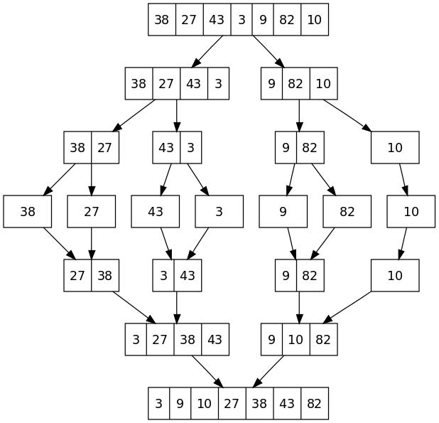
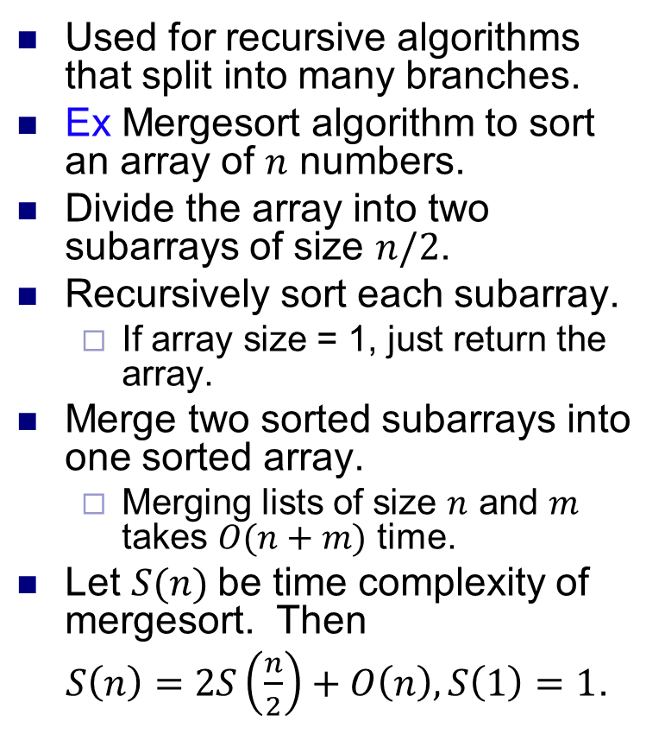
Recursion tree method
Used for recursive algorithms that split into many branches.
Ex Mergesort algorithm to sort an array of $n$ numbers.
Divide the array into two subarrays of size $n/2$.
Recursively sort each subarray.
If array size = 1, just return the array.
Merge two sorted subarrays into one sorted array.
Merging lists of size $n$ and $m$ takes $O(n+m)$ time.
Let $S(n)$ be time complexity of mergesort. Then
$S\left(n\right)=2S\left(\frac{n}{2}\right)+O\left(n\right), S\left(1\right)=1$.
Source: Wikipedia

Slide 28
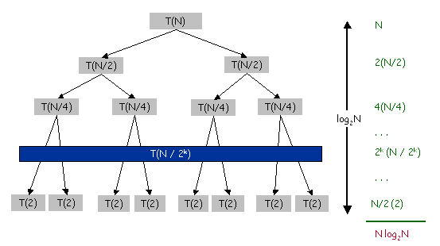
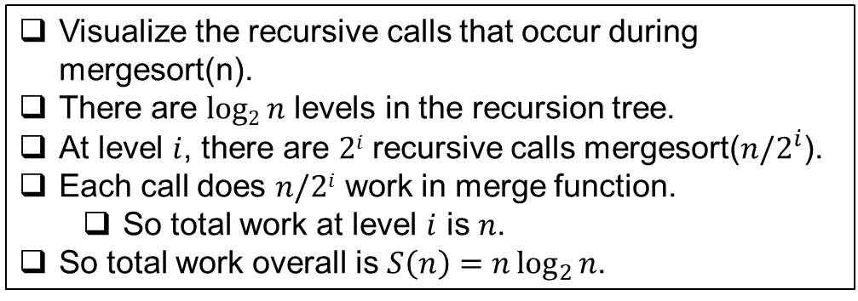
Recursion tree method
void mergesort(n) {
if (n==1)
return;
else {
L=mergesort(n/2);
R=mergesort(n/2);
}
// takes O(n) time
merge(R,L);
}
Visualize the recursive calls that occur during mergesort(n).
There are $log2 n$ levels in the recursion tree.
At level $i$, there are $2i$ recursive calls mergesort($n/2^{i}$).
Each call does $n/2i$ work in merge function.
So total work at level $i$ is $n$.
So total work overall is $S\left(n\right)=n\log_{2}{n}$.
Source: http://www.comscigate.com/ cs/IntroSedgewick/40adt/42sort/images/nlogn.png

Slide 29
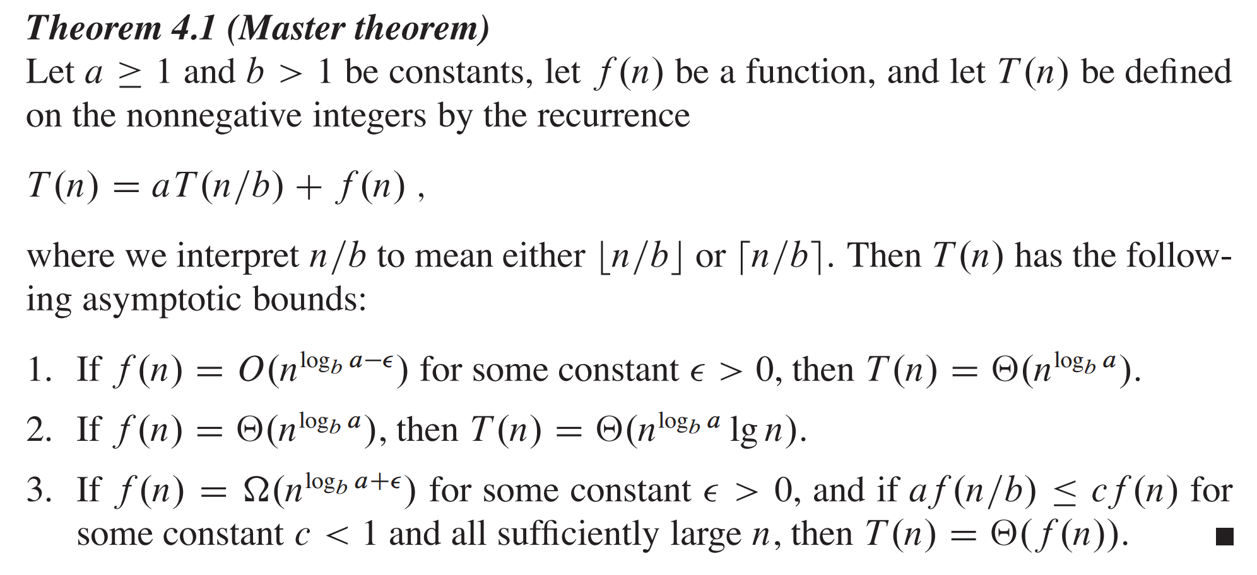
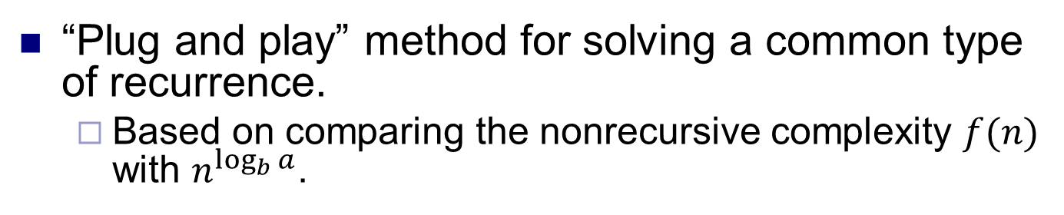
Master theorem
“Plug and play” method for solving a common type of recurrence.
Based on comparing the nonrecursive complexity $f(n)$ with $n^{\log_{b}{a}}$.
Source: Introduction to Algorithms, Cormen et al

Slide 30
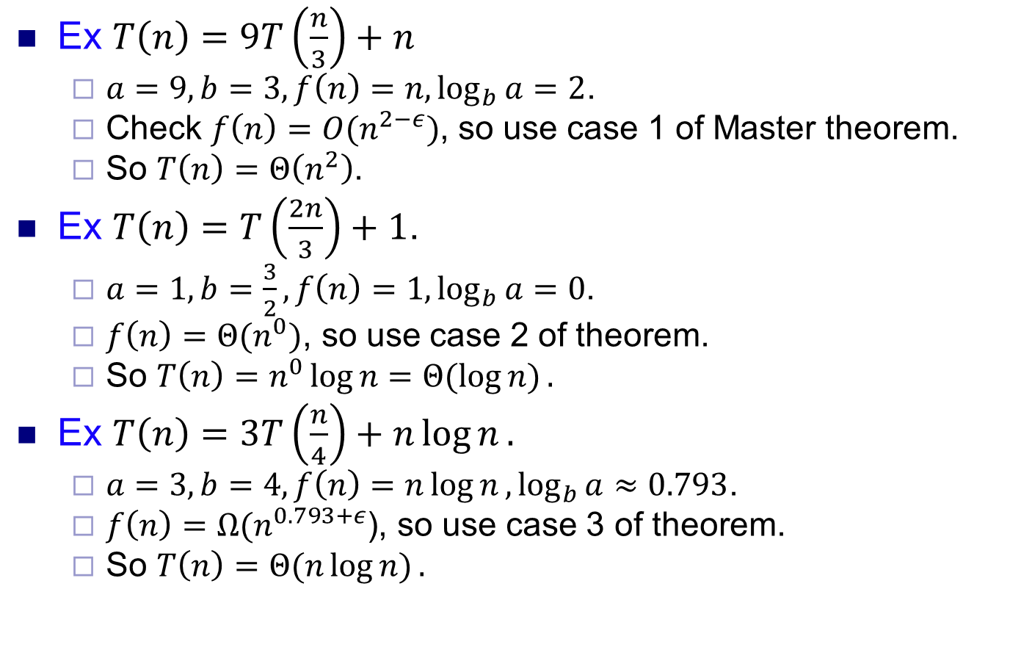
Master theorem examples
Ex $T\left(n\right)=9T\left(\frac{n}{3}\right)+n$
$a=9,b=3,f\left(n\right)=n,\log_{b}{a=2}$.
Check $f\left(n\right)=O(n^{2−ε})$, so use case 1 of Master theorem.
So $T\left(n\right)=Θ\left(n^{2}\right)$.
Ex $T\left(n\right)=T\left(\frac{2n}{3}\right)+1$.
$a=1, b=\frac{3}{2},f\left(n\right)=1,\log_{b}{a=0}$.
$f\left(n\right)=Θ(n^{0})$, so use case 2 of theorem.
So $T\left(n\right)=n^{0}\log{n=Θ(\log{n)}}.$
Ex $T\left(n\right)=3T\left(\frac{n}{4}\right)+n\log{n}.$
$a=3,b=4,f\left(n\right)=n\log{n},\log_{b}{a≈0.793}$.
$f\left(n\right)=Ω(n^{0.793+ε}$), so use case 3 of theorem.
So $T\left(n\right)=Θ(n\log{n)}.$

Slide 31
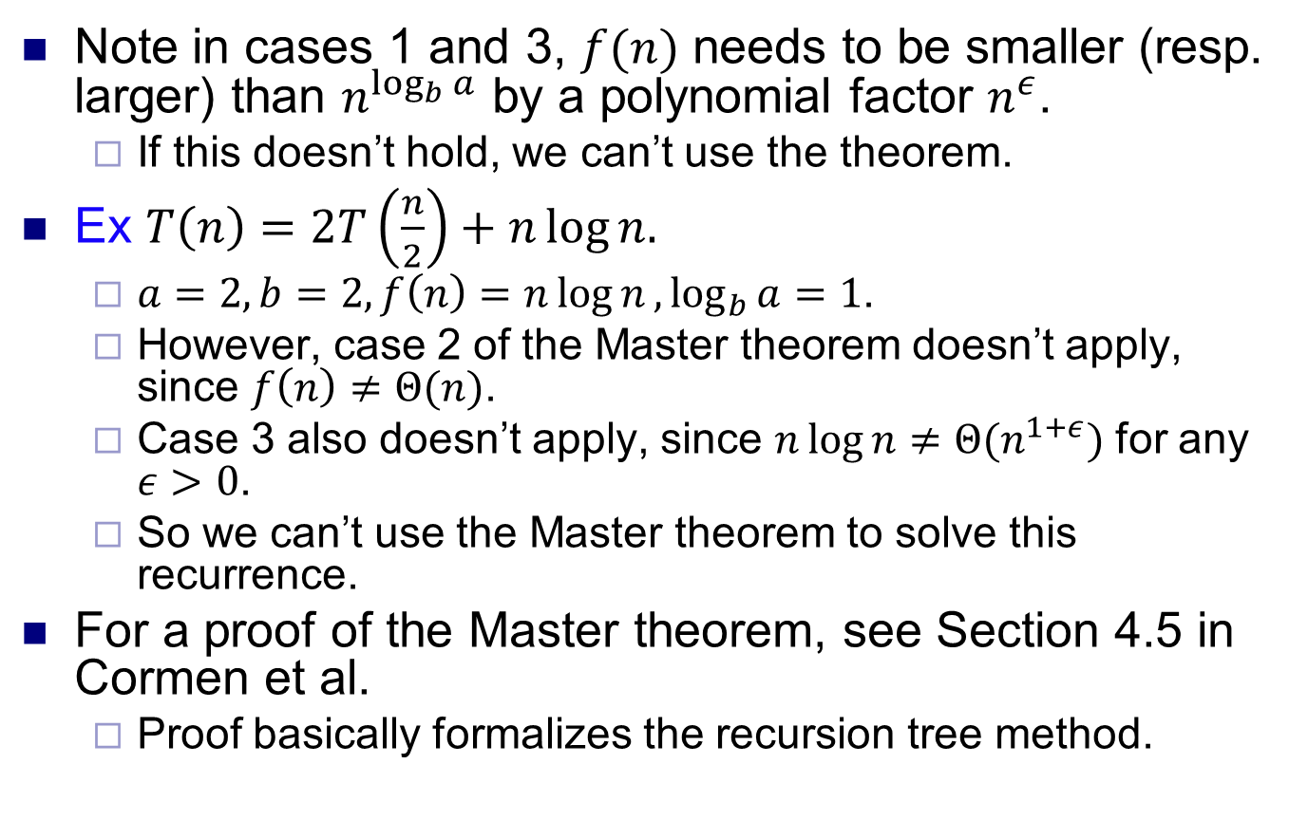
Master theorem caveats
Note in cases 1 and 3, $f(n)$ needs to be smaller (resp. larger) than $n^{\log_{b}{a}}$ by a polynomial factor $n^{ε}$.
If this doesn’t hold, we can’t use the theorem.
Ex $T\left(n\right)=2T\left(\frac{n}{2}\right)+n\log{n.}$
$a=2, b=2, f\left(n\right)=n\log{n},\log_{b}{a=1}$.
However, case 2 of the Master theorem doesn’t apply, since $f\left(n\right)≠Θ(n)$.
Case 3 also doesn’t apply, since $n\log{n≠Θ(n^{1+ε}})$ for any $ε>0$.
So we can’t use the Master theorem to solve this recurrence.
For a proof of the Master theorem, see Section 4.5 in Cormen et al.
Proof basically formalizes the recursion tree method.

